Slide 1

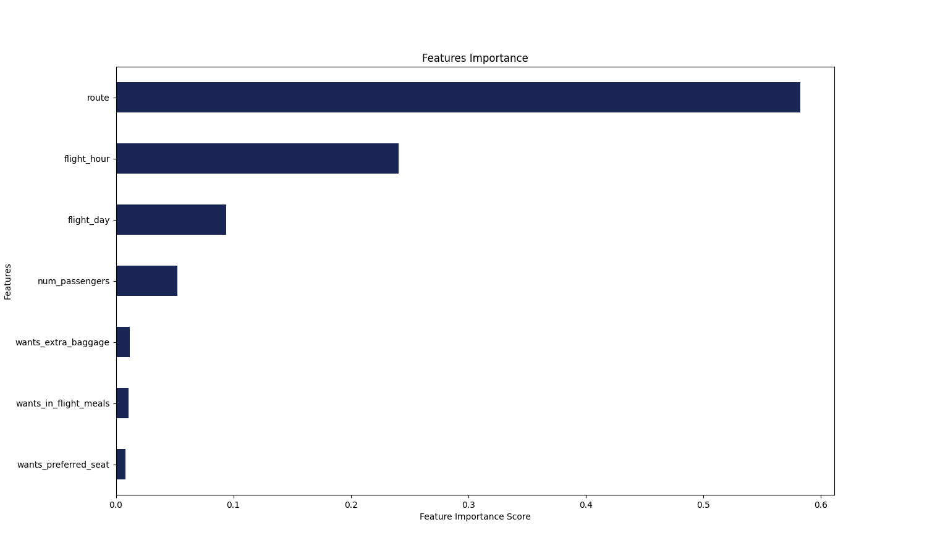
MODELLING RESULT
From the feature importance chart it can be deduced that the features influencing customers to complete their booking is the route(i.e the route taken from the booking origin to the destination) and the flight hour (i,e the hour the flight depart)
The model also has an accuracy of 93% after undergoing cross-validation.

